Slide 1

Algorithms and Data Structures 1 CS 0445
Fall 2023
Recursion – Part 1
Sherif Khattab
ksm73@pitt.edu
(Slides are adapted from Textbook and Dr. Ramirez’s CS 0445 slides.)

Slide 2
Announcements
Upcoming Deadlines:
Lab 3: Friday 10/6 @ 11:59 pm
Programming Assignment 2: Friday 10/20 @ 11:59 pm
Midterm Exam next week
Th 10/12
in-person, closed-book, pencil-and-paper
Study guide and old exam posted on Canvas
Midterm review next Tuesday

Slide 3
Parsing and Evaluating Algebraic Expressions
Check if infix expression is balanced
Convert infix expression to postfix
Evaluate postfix expression

Slide 4
Balance Checking Algorithm
initialize an empty Stack
for each character in the input infix expression
if ‘(‘ → push to Stack
if ‘)’ → pop from stack and check
if a matching pair, continue
else (stack empty or not matching) → unbalanced
if stack not empty → unbalanced
else → balanced

Slide 5
What is the running time?
In terms of n, the length of the input prefix string
How many iterations?
n iterations
What is the runtime of each iteration?
push or pop, check if stack is empty, and a comparison
O(1)
Runtime outside the loop?
Stack initialization and check if stack empty
O(1)
Total runtime = O(1 * n + 1) = O(n)
initialize an empty Stack
for each character in the input infix expression
if ‘(‘ → push to Stack
if ‘)’ → pop from stack and check
if a matching pair, continue
else (stack empty or not matching) → unbalanced
if stack not empty → unbalanced
else → balanced

Slide 6
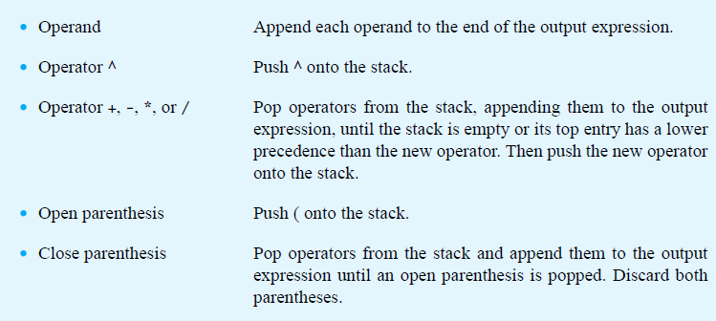
Infix-to-postfix Conversion Algorithm
Initialize an empty operator stack
For each character in the input expression
Pop operators from stack and append to output expression

Slide 7
What is the running time?
In terms of n, the length of the input string
Runtime outside the loop?
Stack initialization and possibly many pop operations
O(1)?
Not always
How many iterations?
n iterations
What is the runtime of each iteration?
Append, push, possibly multiple pops, check if stack is empty, and comparisons
Not always O(1)!
Initialize an empty operator stack
For each character in the input expression
Pop operators from stack and append to output expression

Slide 8
Data structure centric runtime analysis
In terms of n, the length of the input prefix string
How many times does each character get pushed?
at most 1
How many times does each character get pop()’d?
at most 1
What is the runtime of push and pop?
O(1)
Total runtime = O(n)
Initialize an empty operator stack
For each character in the input expression
Pop operators from stack and append to output expression

Slide 9
Postfix Evaluation Algorithm
Initialize an empty operand Stack
for each character in postfix expression
if variable, push its value to Stack
if operator
pop second operand
pop first operand
apply operator to two operands
push result
Return the remaining value in Stack

Slide 10
What is the running time?
In terms of n, the length of the input prefix string
How many iterations?
n iterations
What is the runtime of each iteration?
1 push, 2 pop, check if stack is empty, and one operator application (+, -, *, /, ^_)
O(1)
Runtime outside the loop?
Stack initialization and one pop
O(1)
Total runtime = O(1 * n + 1) = O(n)
Initialize an empty operand Stack
for each character in postfix expression
if variable, push its value to Stack
if operator
pop second operand
pop first operand
apply operator to two operands
push result
Return the remaining value in Stack

Slide 11
Total runtime for the three steps
Total runtime = O(3n) = O(n)
Three passes over the input string!
Can we do better?
Yes! We can use two passes only
Expect to require more space
Typical space-time tradeoff

Slide 12
Evaluating Infix Expressions with 2 passes only
We will use two stacks
Operator Stack
Operand stack
Scan the expression once:
follow the steps of infix conversion to postfix,
except
instead of appending to postfix output, push to operand stack
when popping an operator, pop second then first operands, apply operator, push result to operand stack
While operator stack not empty
pop an operator
pop second operand then first operand
apply the operator and push result to operand stack
Result is the remaining value in the operand stack

Slide 13
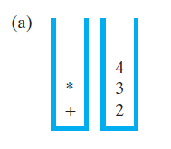
Evaluating Infix Expressions with 2 passes only
Two stacks during the evaluation of a + b * c when a is 2, b is 3, and c is 4:
after reaching the end of the expression;

Slide 14
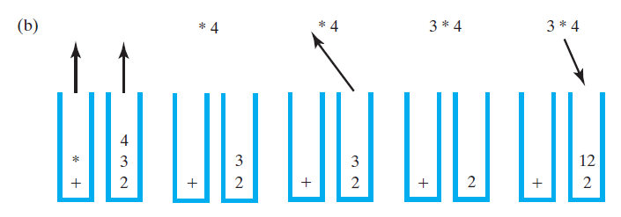
Evaluating Infix Expressions
Two stacks during the evaluation of a + b * c when a is 2, b is 3, and c is 4: while performing the multiplication;

Slide 15
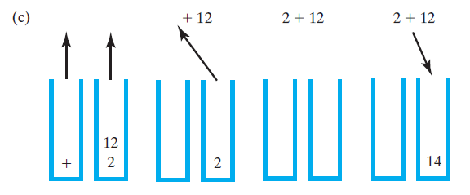
Evaluating Infix Expressions
Two stacks during the evaluation of a + b * c when a is 2, b is 3, and c is 4: (c) while performing the addition

Slide 16
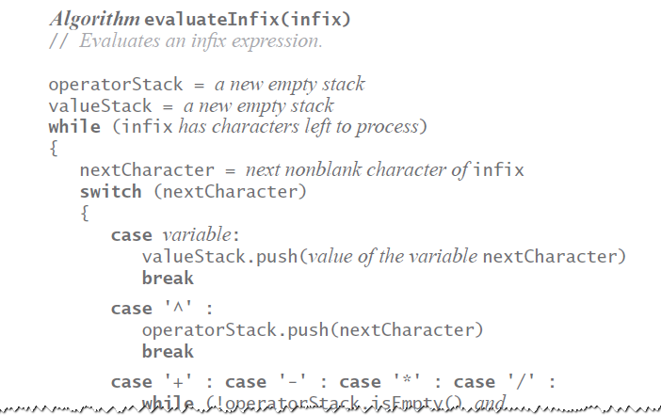
Evaluating Infix Expressions
Algorithm to evaluate infix expression.

Slide 17
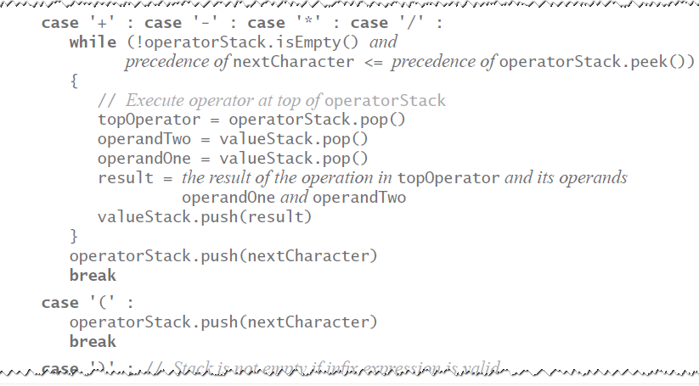
Evaluating Infix Expressions
Algorithm to evaluate infix expression.

Slide 18
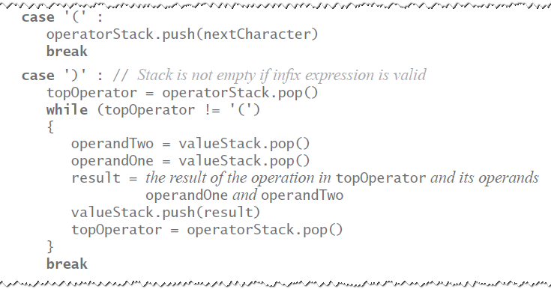
Evaluating Infix Expressions
Algorithm to evaluate infix expression.

Slide 19
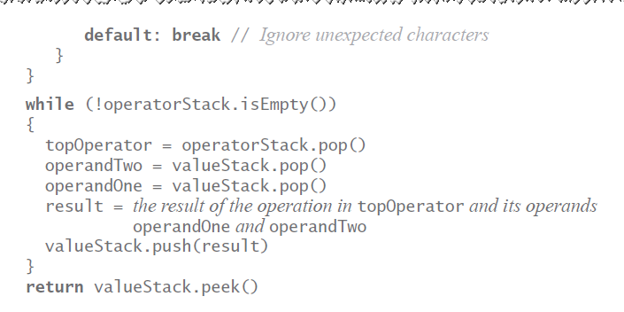
Evaluating Infix Expressions
Algorithm to evaluate infix expression.

Slide 20
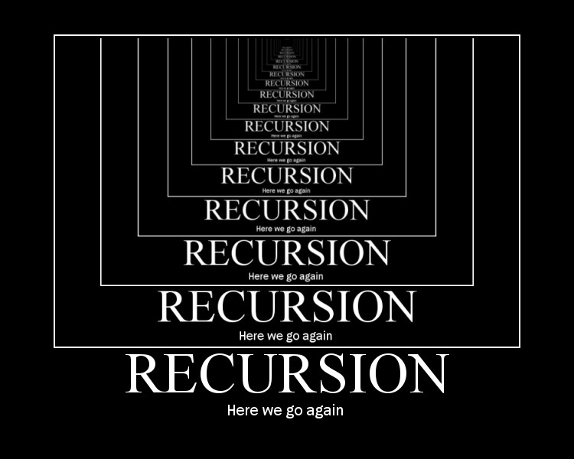
Recursion
Recursion
Source: https://prateekvjoshi.com/2013/10/05/understanding-recursion-part-i/

Slide 21
The Runtime Stack (aka program stack)
Under the hood/behind the scenes alert!
Needed to understand recursion

Slide 22
The Runtime Stack (aka program stack)
A stack is created and used for each running program
called runtime stack
The stack is used to hold data for each method call
in an activation record (aka activation frame or just frame)
Activation record stores:
method parameters
local (method) variables
address of return point (i.e., next statement to execute after returning from call)
When a method is called, its activation record is pushed to the runtime stack
When a method returns, the top activation record is popped

Slide 23
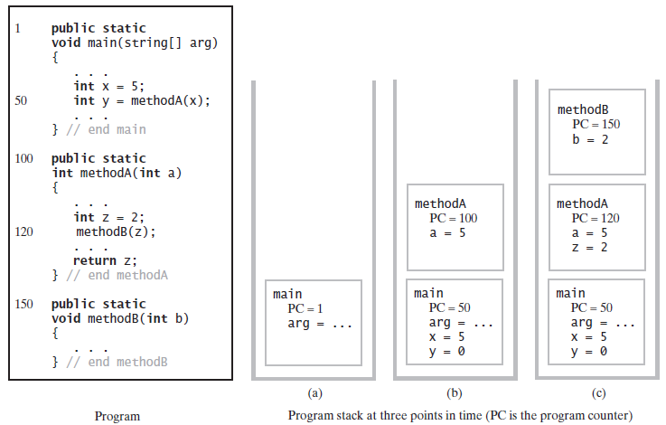
Example
The following code has three methods:
main
methodA
method
main calls methodA
methodA calls methodB
Side note: methodA and methodB must be static
they are called from main, which must be static
What are the local variables of each method?
What are the parameters of each method?

Slide 24
The Program Stack
The program stack when main begins execution
PC is the Program Counter CPU register
it keeps track of the address of the next instruction to execute

Slide 25
The Program Stack
The program stack when methodA begins execution
Before methodA starts, the value of PC is stored in the activation record of main

Slide 26
The Program Stack
The program stack when methodB begins execution
Before methodB starts, the value of PC is stored in the activation record of methodA

Slide 27
What is Recursion?
Consider hiring a contractor to build a house
Contractor hires a subcontractor for a portion of the job
That subcontractor hires a sub-subcontractor to do a smaller portion of job
…
The last sub-sub- … subcontractor finishes
Each one finishes and reports “done” up the line

Slide 28
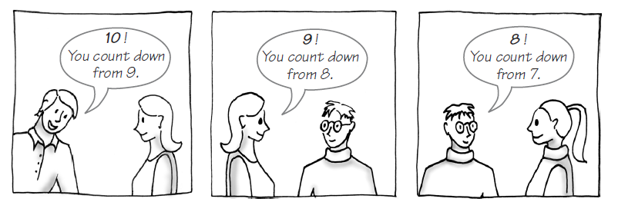
The Countdown Activity
Instructions for each player
When asked by a player to count down from a number
Say the number loudly
If number is 1, report “Done” to the player who asked you
Otherwise
Choose another player
Ask them for their name
Ask them to count down from number – 1
Wait until you receive “Done” from them
Report “Done” to the player who asked you

Slide 29
The Countdown Activity
This is recursion!
Each player is following the same algorithm
Each player represents one recursive call
One activation record on the runtime stack

Slide 30
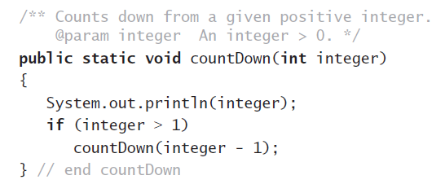
Example: The Countdown
Recursive Java method to do countdown.

Slide 31
Example: The Countdown
Recursive Java method to do countdown.

Slide 32
Example: The Countdown
Recursive Java method to do countdown.

Slide 33
Example: The Countdown
Recursive Java method to do countdown.

Slide 34
Example: The Countdown
Each call to the countdown method corresponds to one person
what did each person do?
say a number

Slide 35
Example: The Countdown
Each call to the countdown method corresponds to one person
what did each person do?
say a number
check if not done

Slide 36
Example: The Countdown
Each call to the countdown method corresponds to one person
what did each person do?
say a number
check if not done
ask a classmate to count down starting from the number before

Slide 37
Definition
Recursion is a problem-solving approach
Breaks a problem into identical but smaller problems.
A method that calls itself is a recursive method.
The invocation is a recursive call or recursive invocation.

Slide 38
Design Guidelines
Recursive method must be given at least one input value

Slide 39
Design Guidelines
Method must be given an input value
Method definition must contain logic that involves this input, leads to different cases

Slide 40
Design Guidelines
Method must be given an input value
Method definition must contain logic that involves this input, leads to different cases
One or more cases should provide solution that does not require recursion
otherwise, infinite recursion
if integer <= 1 → return

Slide 41
Design Guidelines
Method must be given an input value
Method definition must contain logic that involves this input, leads to different cases
One or more cases should provide solution that does not require recursion
One or more cases must include a recursive invocation

Slide 42
Programming Tip
Iterative method contains a loop
Recursive method calls itself
Some recursive methods contain a loop and call themselves
If the recursive method with loop uses while, make sure you did not mean to use an if statement

Slide 43
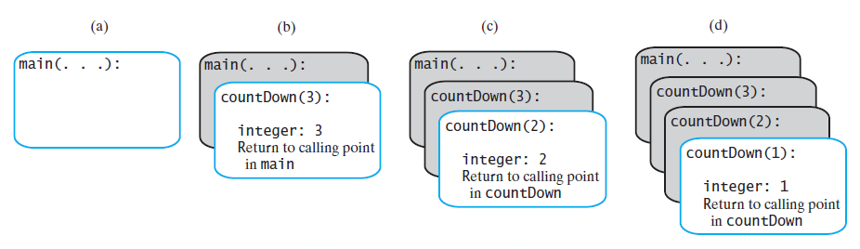
Tracing a Recursive Method
The stack of activation records during the execution of the call countDown(3)
pushing → activation records pile up

Slide 44
Tracing a Recursive Method
The stack of activation records during the execution of the call countDown(3)
pushing → activation records pile up

Slide 45
Tracing a Recursive Method
The stack of activation records during the execution of the call countDown(3)
pushing → activation records pile up

Slide 46
Tracing a Recursive Method
The stack of activation records during the execution of the call countDown(3)
pushing → activation records pile up

Slide 47
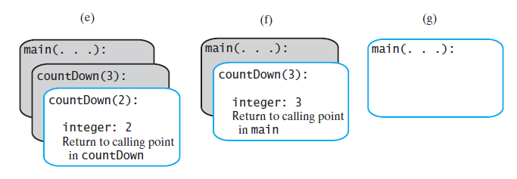
Tracing a Recursive Method
The stack of activation records during the execution of the call countDown(3)
popping → activation records tear down

Slide 48
Tracing a Recursive Method
The stack of activation records during the execution of the call countDown(3)
popping → activation records tear down

Slide 49
Tracing a Recursive Method
The stack of activation records during the execution of the call countDown(3)
popping → activation records tear down

Slide 50
Stack of Activation Records
Each call to a method generates an activation record
Recursive method uses more memory than an iterative method
Each recursive call generates an activation record
If recursive call generates too many activation records, could cause stack overflow

Slide 51

Activity: Calculate
Instructions for each player
When asked by a player to sum from 1 up to a number
If number is 1, report 1 to the player who asked you
Otherwise
Write down the number
Choose another player
Ask them for their name
Ask them to sum from 1 up to number – 1
Wait until you receive result from the player
Thank them!
Add the number you wrote down to the result you got from the player
Tell the player who asked you the result

Slide 52
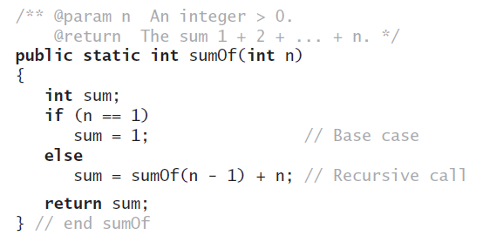
Recursive Methods That Return a Value
Recursive method to calculate

Slide 53
Recursive Methods That Return a Value
Recursive method to calculate

Slide 54
Recursive Methods That Return a Value
Recursive method to calculate

Slide 55
Recursive Methods That Return a Value
Recursive method to calculate

Slide 56
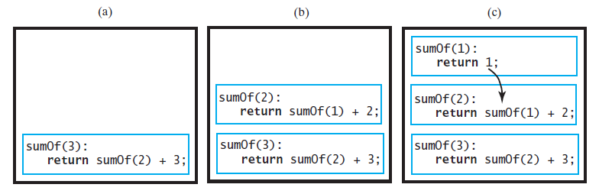
Tracing a Recursive Method
Tracing the execution of sumOf(3)

Slide 57
Tracing a Recursive Method
Tracing the execution of sumOf(3)

Slide 58
Tracing a Recursive Method
Tracing the execution of sumOf(3)

Slide 59
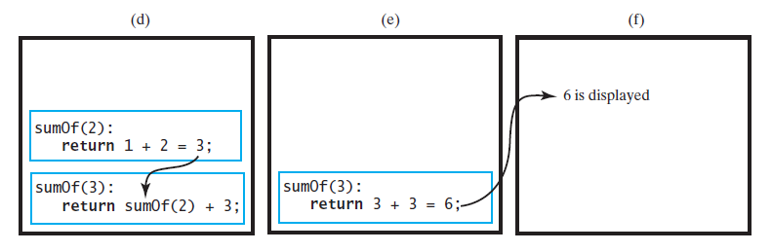
Tracing a Recursive Method
Tracing the execution of sumOf(3)

Slide 60
Tracing a Recursive Method
Tracing the execution of sumOf(3)

Slide 61
Tracing a Recursive Method
Tracing the execution of sumOf(3)

Slide 62
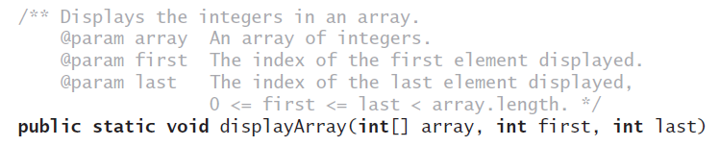
Recursively Processing an Array
A recursive method to display array.

Slide 63
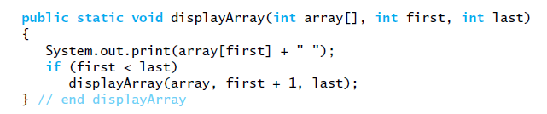
Recursively Processing an Array
Starting with array[first]

Slide 64
Recursively Processing an Array
Starting with array[first]

Slide 65
Recursively Processing an Array
Starting with array[first]
What is wrong with this method?

Slide 66
Recursively Processing an Array
Starting with array[first]
We need a base (non-recursive) case!
ask for help only when there is at least one array entry to display
otherwise, return

Slide 67
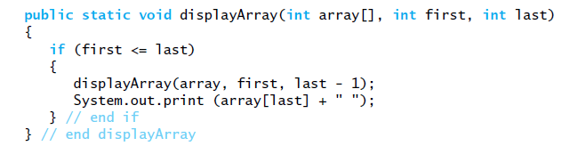
Recursively Processing an Array
Alternatively, …

Slide 68
Recursively Processing an Array
Alternatively, …

